Slide 1

History of Aspirin Drug
Student’s Name

Slide 2
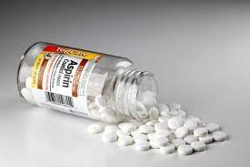
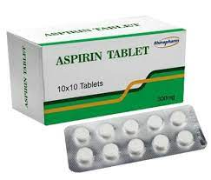
History of Aspirin
Aspirin is one the most pharmacological achievements of the 21st century in reducing fever and relieving mild to moderate pain in the body.
Medicinal historians trace the birth of Aspirin in 1897.
The drug was first discovered by German chemist, Dr. Felix Hoffman as first drug made synthetically in the pharmaceutical industry.
Following a series of animal experiments and successful human trials, the first compound of the drug was named Aspirin and registered on February 1st 1899 (International Aspirin Foundation, 2023).
Notes:
Aspirin is a salicylate and a nonsteroidal anti-inflammatory drug (NSAID) that reduces fever and relieves mild to moderate pain in the body. Aspirin is considered the most widely used drug for the conditions mentioned above and is one of the milestone pharmacological achievements of the 20th century. While the fascinating history of Aspirin dates back 3500 years, historians of medicine trace its birth to 1897 (Montinari et al., 2019). During its discovery, a famous German chemist at Friedrich Bayer and Co. focused on the phenol group while other researchers concentrated on the carboxylic acid group. On August 10th, 1897, he became the first scientist to acetylate the phenol group and produce a pure, stable acetylsalicylic acid (ASA). This discovery marked the first time a drug had been made through a synthetic process and marked Hoffman as the birth of both Aspirin and the pharmaceutical industry (International Aspirin Foundations, 2023). After recognizing the incredible discovery of Dr. Hoffman, other scientists tested the drug first on him and then performed tremendous animal experiments before experimenting with successful clinical trials in humans. After successful trials, the first component of Aspirin was named and registered on February 1st 1899.

Slide 3
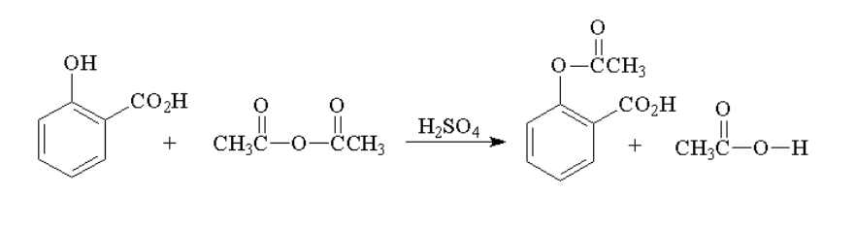
Synthesis of Aspirin
Synthesis of aspirin drug includes several stages ranging from preparation of materials to chemical reactions and purification processes.
The following steps are involved in the process:
Preparation of materials
Acetylation
Cooling and Purification
Analytical characterization
Formulation
Notes:
Aspirin is synthesized from salicylic acid through chemical processes; this process is achieved through acetylation with acetic anhydride. The raw materials used in the acetylation reaction are salicylic acid, naturally obtained from willow bark or phenol group components, and acetic anhydride, the acetylating agent. The acetylation process occurs in a laboratory setting where salicylic acid is mixed with excess acetic anhydride in the presence of a catalyst, usually sulfuric or phosphoric acid. The reaction is facilitated by heating the mixture gently in a water bath. The reaction results in the acetyl group (-COCH3) replacing the salicylic acid’s hydroxyl group (-OH), forming aspirin and acetic acid as the by-product.The next step is purification, which involves cooling the mixture and precipitating the aspirin into its solid crystalline form. The crude aspirin product is then filtered from the unreacted materials in the mixture and washed with a suitable solvent to remove impurities. The purified aspirin is then dried under a vacuum maintained at room temperature to remove the remaining solvent.The next step involved analytical characterization to purify and identify synthesized aspirin. After pure aspirin crystals are obtained, they are formulated into various dosages as either tablets or capsules.

Slide 4
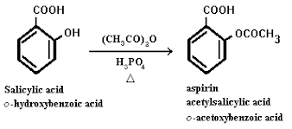
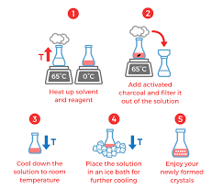
How Aspirin is Made
Aspirin is prepared through the following processes:
Chemical synthesis from salicylic acid.
Preparation through acetylation
Purification of crude mixture from acetylation
Cooling and drying of Aspirin crystals
Notes:
Aspirin is prepared from salicylic acid through chemical synthesis. The core synthesis process involved is acetylation with acetic anhydride (International Aspirin Foundation, 2023). The primary material, salicylic acid, is obtained from plants such as willow bark through hydrolysis of the natural compound. Alternatively, the Kolbe-Schmitt reaction can synthesize this material [salicylic acid] from phenol group components. Next, an acetyl group (-COCH3) is added to the hydroxyl group (-OH) to acetylate the salicylic acid. This reaction takes place with an acetylating agent, acetic anhydride, and sulfuric acid as the catalyst.
Next, the crude mixture formed during acetylation is purified to obtain aspirin products. Other purification processes, such as filtration, crystallization, and recrystallization, are added to remove impurities from the pure aspirin crystals. Lastly, the pure aspirin crystals are dried and cooled at room temperature. These processes are necessary to remove any solvents remaining from the aspirin crystals. The obtained crystals are then formulated into tablets or capsules for oral administration. The molecular weight of the obtained crystals is approximately 180.16g/mol.

Slide 5
Bio-Metabolism of Aspirin
Like many other pharmaceutical drugs, the bio-metabolism of aspirin takes place in the liver, and it involves two main processes.
Phase 1: reduction or hydrolysis of the drug
Phase 2: conjugation
Notes:
Bio-metabolism is the enzymatic conversion of one chemical compound into another. Like many other pharmaceutical drugs, the metabolism of aspirin also takes place in the liver. As the metabolism continues, its therapeutic effect diminishes, thus making it more effective in the body. The first phase of metabolism involves reduction or hydrolysis processes, but the most common biochemical process that takes place is oxidation. The drug is said to be oxidized when it is exposed into oxygen in the air and catalyzed by cytochrome P450 enzymes. In the second metabolism phase, the drug undergoes conjugation where an ionized group is attached to the drug making it more water soluble. Aspirin is either conjugated with glycine or glucuronic acid to form ionized metabolites that can be excreted through urine.

Slide 6
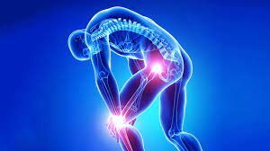



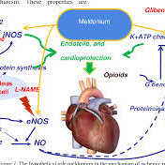
What Aspirin Does in the Body
Analgesic Function
(Pain relief)
Anti-Inflammation
Antipyretic
Fever reduction
Prevention of Preeclampsia
Cardioprotective Effects
Notes:
Aspirin exerts multipurpose functions in the body due to its pharmacological properties. Firstly, it plays a vital role in relieving pain. Aspirin inhibits the synthesis of prostaglandin substances, which necessitates pain reduction in body parts such as the head, teeth, and women during their periods. The prostaglandins play another important anti-inflammatory role, thus making the drug helpful in reducing inflammation-related conditions such as injuries and arthritis. Similarly, it lowers body fever by acting on the hypothalamus to regulate body temperature.
On expectant mothers, low doses of aspirin are prescribed to reduce the risk of preeclampsia, especially in mothers infected with high blood pressure and proteinuria. Finally, aspirin is prescribed for individuals with cardiovascular infections due to its antiplatelet properties. It combats blood clotting that can lead to more severe heart infections like stroke and heart attack.

Slide 7
Controversies of Aspirin
Gastrointestinal Side Effects
Bleeding Risk
Interaction with Other Medications​
Notes:
Taking aspirin contrary to the physician’s prescription may result in gastrointestinal complications such as excessive bleeding, stomach ulcers, and perforation. Accordingly, long-term use of aspirin can irritate the stomach lining, leading to gastrointestinal bleeding, especially in individuals with a history of peptic ulcers or gastrointestinal bleeding. Similarly, due to its antiplatelet properties, aspirin reduces the ability of the blood to clot. Despite this property being essential in preventing heart diseases, it increases the risk of bleeding.The interaction of aspirin with other drugs increases its controversy as a safe drug. It quickly interacts with other anticoagulant medications, such as warfarin and newer oral anticoagulants, leading to further complications such as severe bleeding. If the drug is taken together with medicines used to treat complications such as hypertension and medications, it may affect their efficacy and safety. Thus, while aspirin offers a variety of health benefits to patients, its use is associated with controversial issues.

Slide 8
International Aspirin Foundation (2023). The Aspirin Story. https://www.aspirin-foundation.com/history/the-aspirin-story/ Montinari, M. R., Minelli, S., & De Caterina, R. (2019). The first 3500 years of aspirin history from its roots - A concise summary. Vascular pharmacology, 113, 1–8. https://doi.org/10.1016/j.vph.2018.10.008 University of Nottingham (n.d.). The Liver and Drug Metabolism. https://www.nottingham.ac.uk/nmp/sonet/rlos/bioproc/liverdrug/index.html
References

